Slide 1

Hospital Medicare Expenditures: Pre, During, Post Covid
Zainab Shafi, Key Caughey, Wally Diaz, Kevin Xie

Slide 2

Data:Overview
The four datasets, sourced from the Centers for Medicare & Medicaid Services, comprise the average Medicare claims per patient across hospitals and medical facilities in all 50 states of the United States. Spanning the years 2019 to 2022, this comprehensive data encapsulates the period leading up to, during, and following the impact of the Covid-19 pandemic

Slide 3

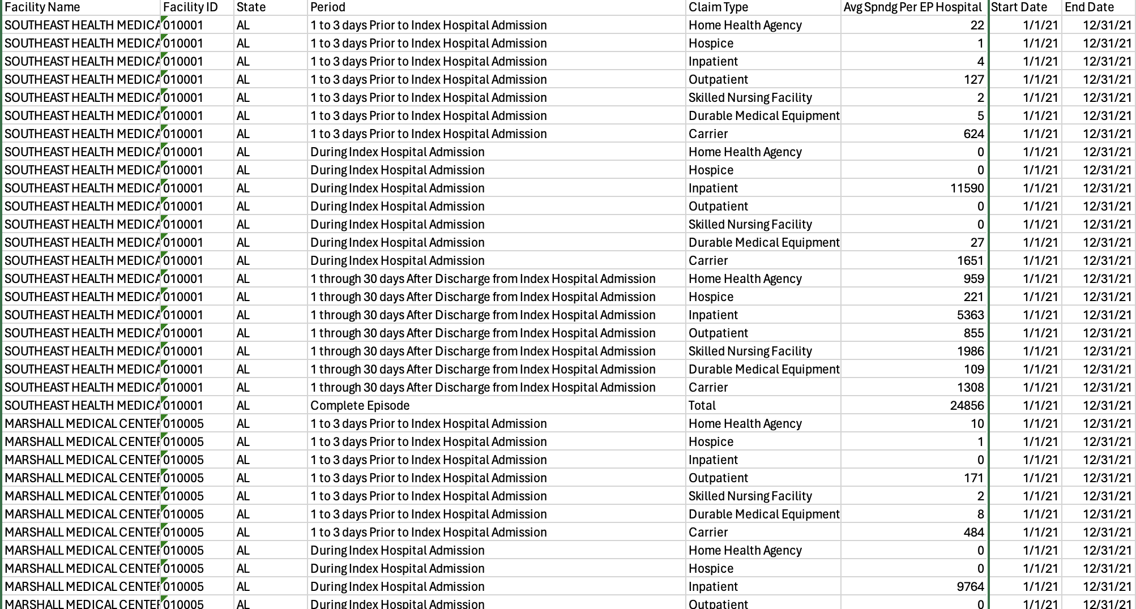
Data:Quick Facts
Each dataset spans an entire year, 1/1 - 12/31.
Exception: 2020, peak PHE(COVID). Aggregated claims data omitted from public record.
2020 data beings 7/1/2020
Looks at 7 claim types, for 3 patient care duration periods, in each facility
Hospitals choose to provide claims based data, facility numbers/state not uniform

Slide 4
Data Manipulation / Cleaning
Filtered unnecessary/obscure columns - State + National Avgs
2 main dataframes : focus on 7 claim types and 3 different index period
Calculations and group-bys to evaluate totals of claim types(yearly + all years)
General -> Granular
Overall total claim trends -> specific claim type trends
National -> Top 10 spending States
Highest spending claim type -> filter top 5 hosps

Slide 5

Data: Questions
How does Medicare spending behavior vary across states, and what's the impact of COVID-19?
Which claim types see the highest spending?
Which claim periods see the highest spending?
Is there a trend of rising average spending, and how is COVID-19 influencing it?
What forecasts can the data provide for future Medicare spending trends?
j
Notes:
How does Medicare spending behavior vary across states, and did COVID19 impact these trends?
Which claim types are allocated the highest spending?
Which claim periods are allocated the highest spending?
Has there been a trend of rising average spending over the years, and to what extent has COVID-19 effected this pattern?
What potential forecasts does the data provide for future trends in Medicare spending?

Slide 6
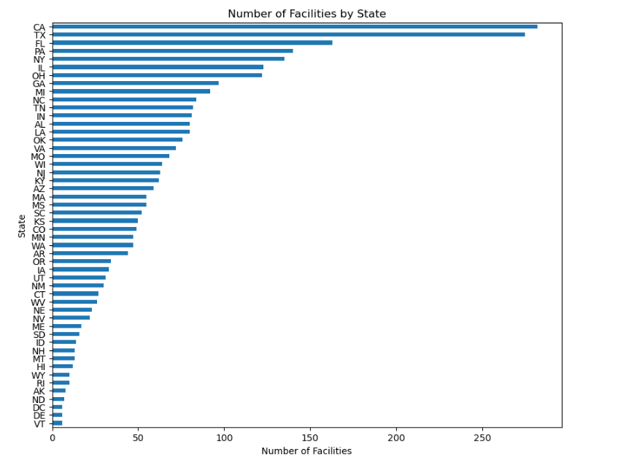
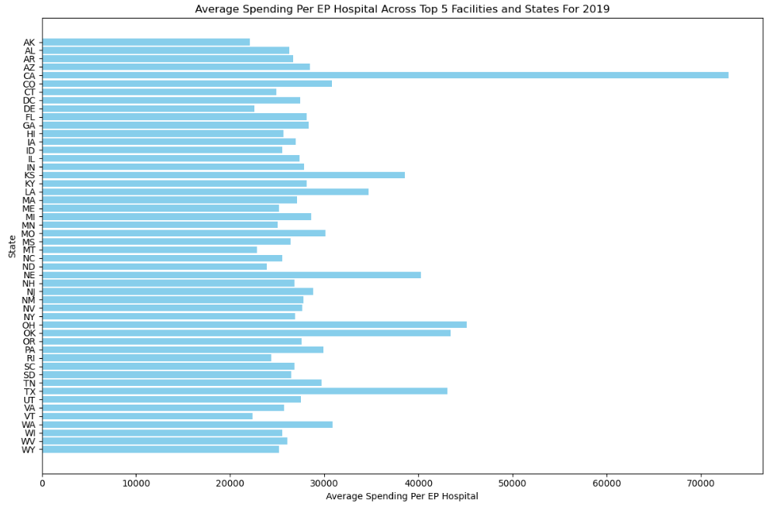
Which States have the highest average spending per Hospital in medicare claims?
Most facilities reported: CA/TX -> CA Avg Spending highest, seen across years.
Southern/Mid Western states significant (TX,OH,KS)

Slide 7
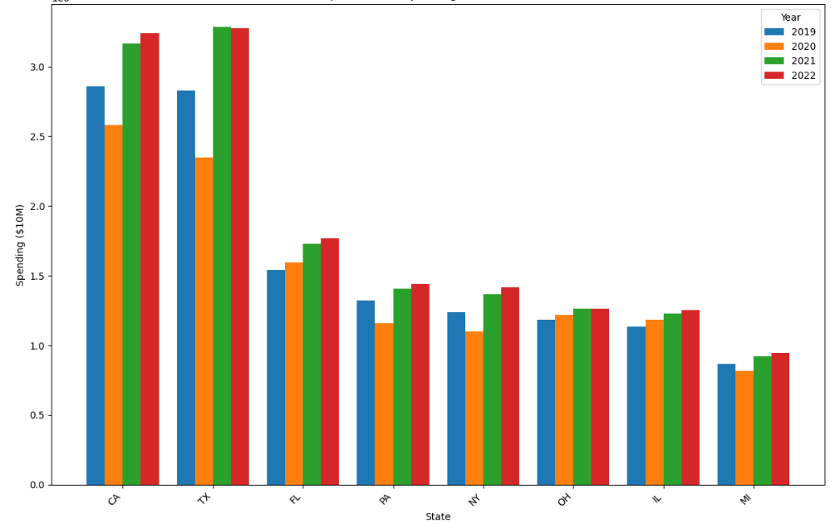
Top 8 States Spending For 2019 To 2022

Slide 8
CA highest spender 2019-2020, TX highest 2021-2022
6mos for 2020 vs preceding and subsequent years
CA: 2019 = 2.75mil, 2020 = 2.5 mil, 2021 = 3.25 mil
TX: 2019 =2.7 mil , 2020 = 2.25 mil , 2021 = 3.25 mil
FL: 2019 = 1.5 mil , 2020 =1.65 mil, 2021 = 1.75 mil
NY: 2019 = 1.25 mil , 2020= 1 mil , 2021 = 1.5 mil
Approx/incomplete numbers for 2020

Slide 9
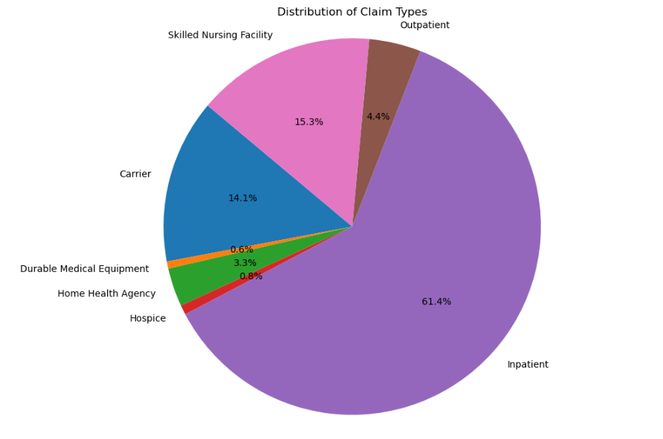
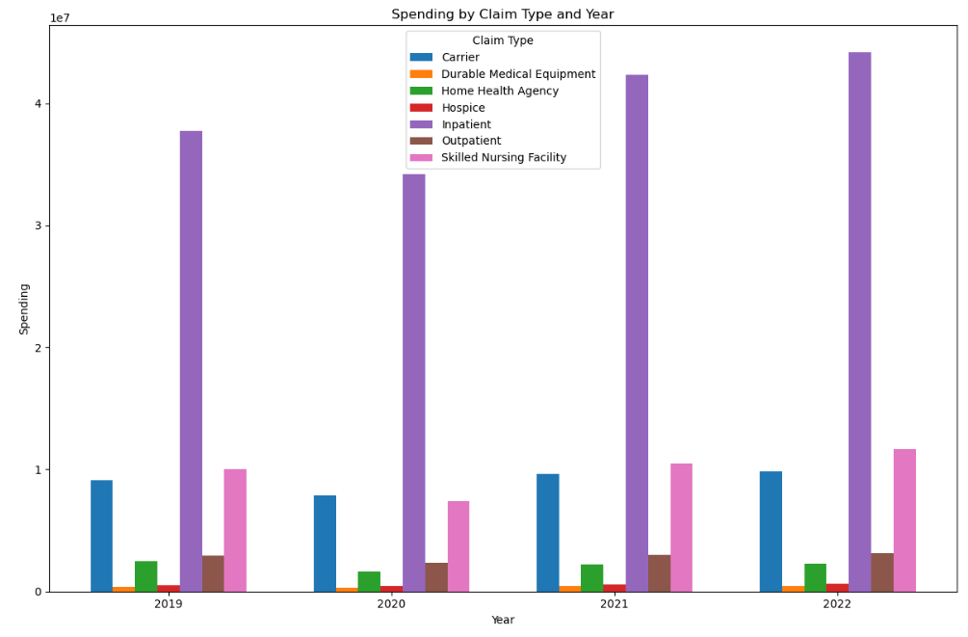
Which claim types are the most expensive?
Inpatient, Skilled Nursing Facility, and Carrier. Inpatient data leads. Observe 6mos of 2020 data compared with other years.
More medicare resources allocated to Inpatient claims, in both visualizations

Slide 10
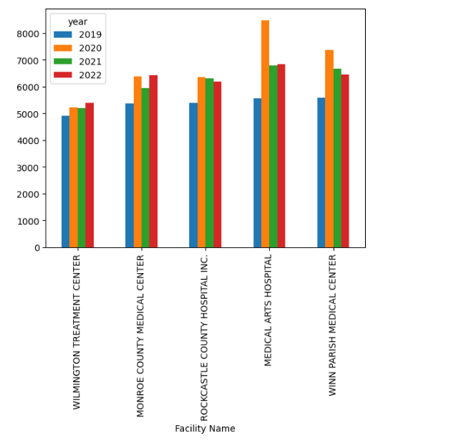
Question 2 Cont.
Inpatient claims for top spending hosps
Top 5 hospitals from 2019 tracked across 4 years
Uses Inpatient Claims data
2020’s inpatient avg claims expenditures

Slide 11
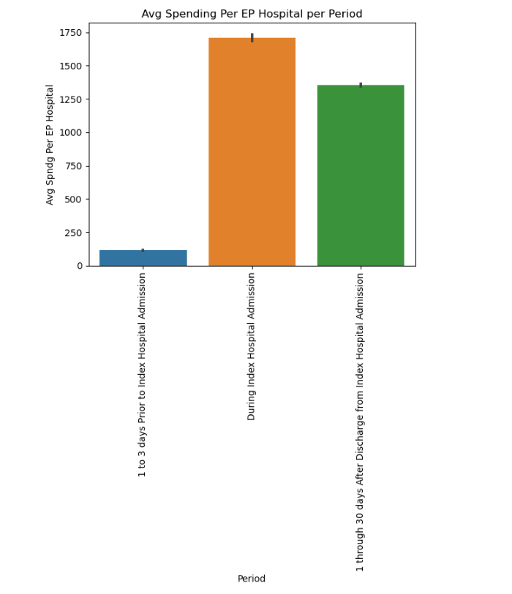
Which period had the most average spending per Hospital?
Which period had the most average spending per EP Hospital?
During, After, then Prior
During: emergent cases - “Inpatient”
Prior: Unlikely to file claim vs
After: those in the hospital and after care.

Slide 12
Period vs Average Spending Cont.
Data supports “Inpatient” Medicare claims being most common + most allocated resources
Inpatient Claims are brought during hospital admission
Medicare covered “necessary” COVID treatment for Inpatient Claims

Slide 13
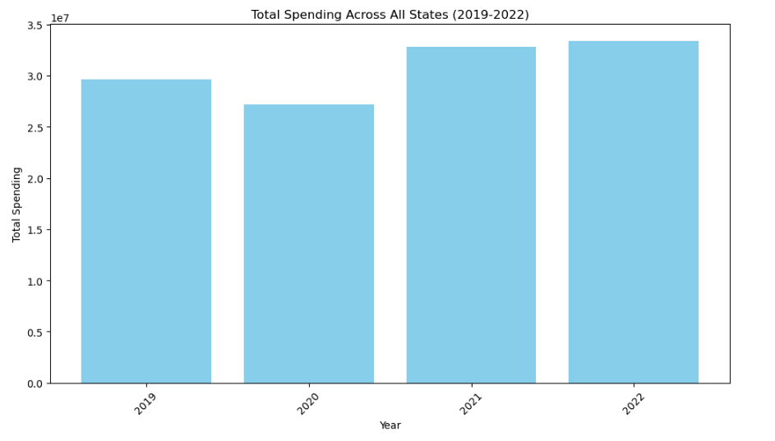
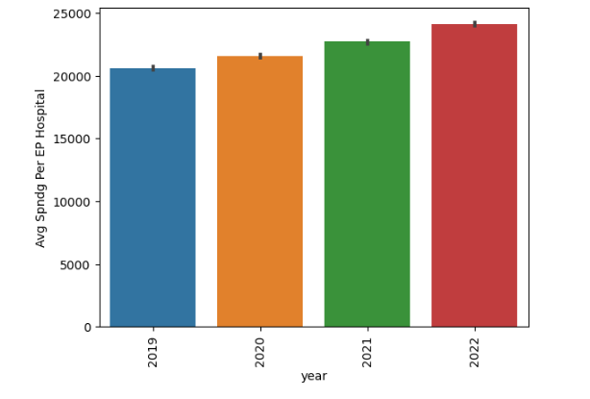
Has the average spending increased over the years went on and has COVID had an impact?
Spending has increased and covid has played a major role. 2020 data is only 1/2 the year and it rivals the other years in spending.
Total spending trends upwards, supported by the graphs

Slide 14
Leading from our previous graphs on Inpatient Claims, During Index Hospital Admission - these graphs display those specific claims and their costs
Data accounting for 2020 only reflects costs for half of the year due to COVID easily skewing the data.
Spending in total across all states and spending average in hospitals was almost as much as costs for the whole year in 2019, 2021 and 2022.
COVID played a role in cost increases was due to an increase in the number of hospitalizations, which increased inpatient spending across all states as well as average per hospitals.

Slide 15
Forecasts: Medicare Spending
Medicare Accounts for 21% of National Health Spending and 10% of Federal Budget
“Medicare Benefits Spending Is Projected to Increase from $829 Billion in 2021 to $1.8 Trillion in 2031, Due to Growth in the Medicare Population and Increases in Health Care Costs”.
Visual representations of our data support this prediction, our yearly data as pictured in the previous bar graph is on an incline.

